Slide 1

SONG RECOMMENDER
Sergio Andrés Burgos Zuleta,
Amra Fetic,
Marina Llompart

Slide 2

How did it all start?

Slide 3
One day we received an intriguing request that would lead us to create a song recommendation system. It all started one afternoon when we were sitting in our favourite coffee shop, sipping a cup of coffee and engrossed in our laptops, coding and working on several labs, when we noticed the music surrounding us. Then the barista saw us coding and asked if we could help him to create a song recommender that can distinguish between 'hot' and 'not hot' songs. He told us that for him "hot" songs were not just those topping the charts but those that resonated with people on a deeply emotional level. So, we couldn't resist the opportunity to work on a project that combined our love for tech and passion for music. We began our request by collecting data, analysing audio features, and delving into user preferences and this is how we built a recommendation system.

Slide 4
Steps of the process
Data collection
Billboard Hot 100 – Billboard
Spotify Top Hit 2010-2022 | Kaggle
“Hot” songs
Not Hot” songs
Cleaning
Web-scrapping
API
Audio Features
Modelling
Song clusters

Slide 5
Steps of the process
Song recommender
User input song
Is it a “Hot” song?
Yes
Recommend a “Hot” song
No
Find all audio features of the song
Recommend a song from the same cluster

Slide 6
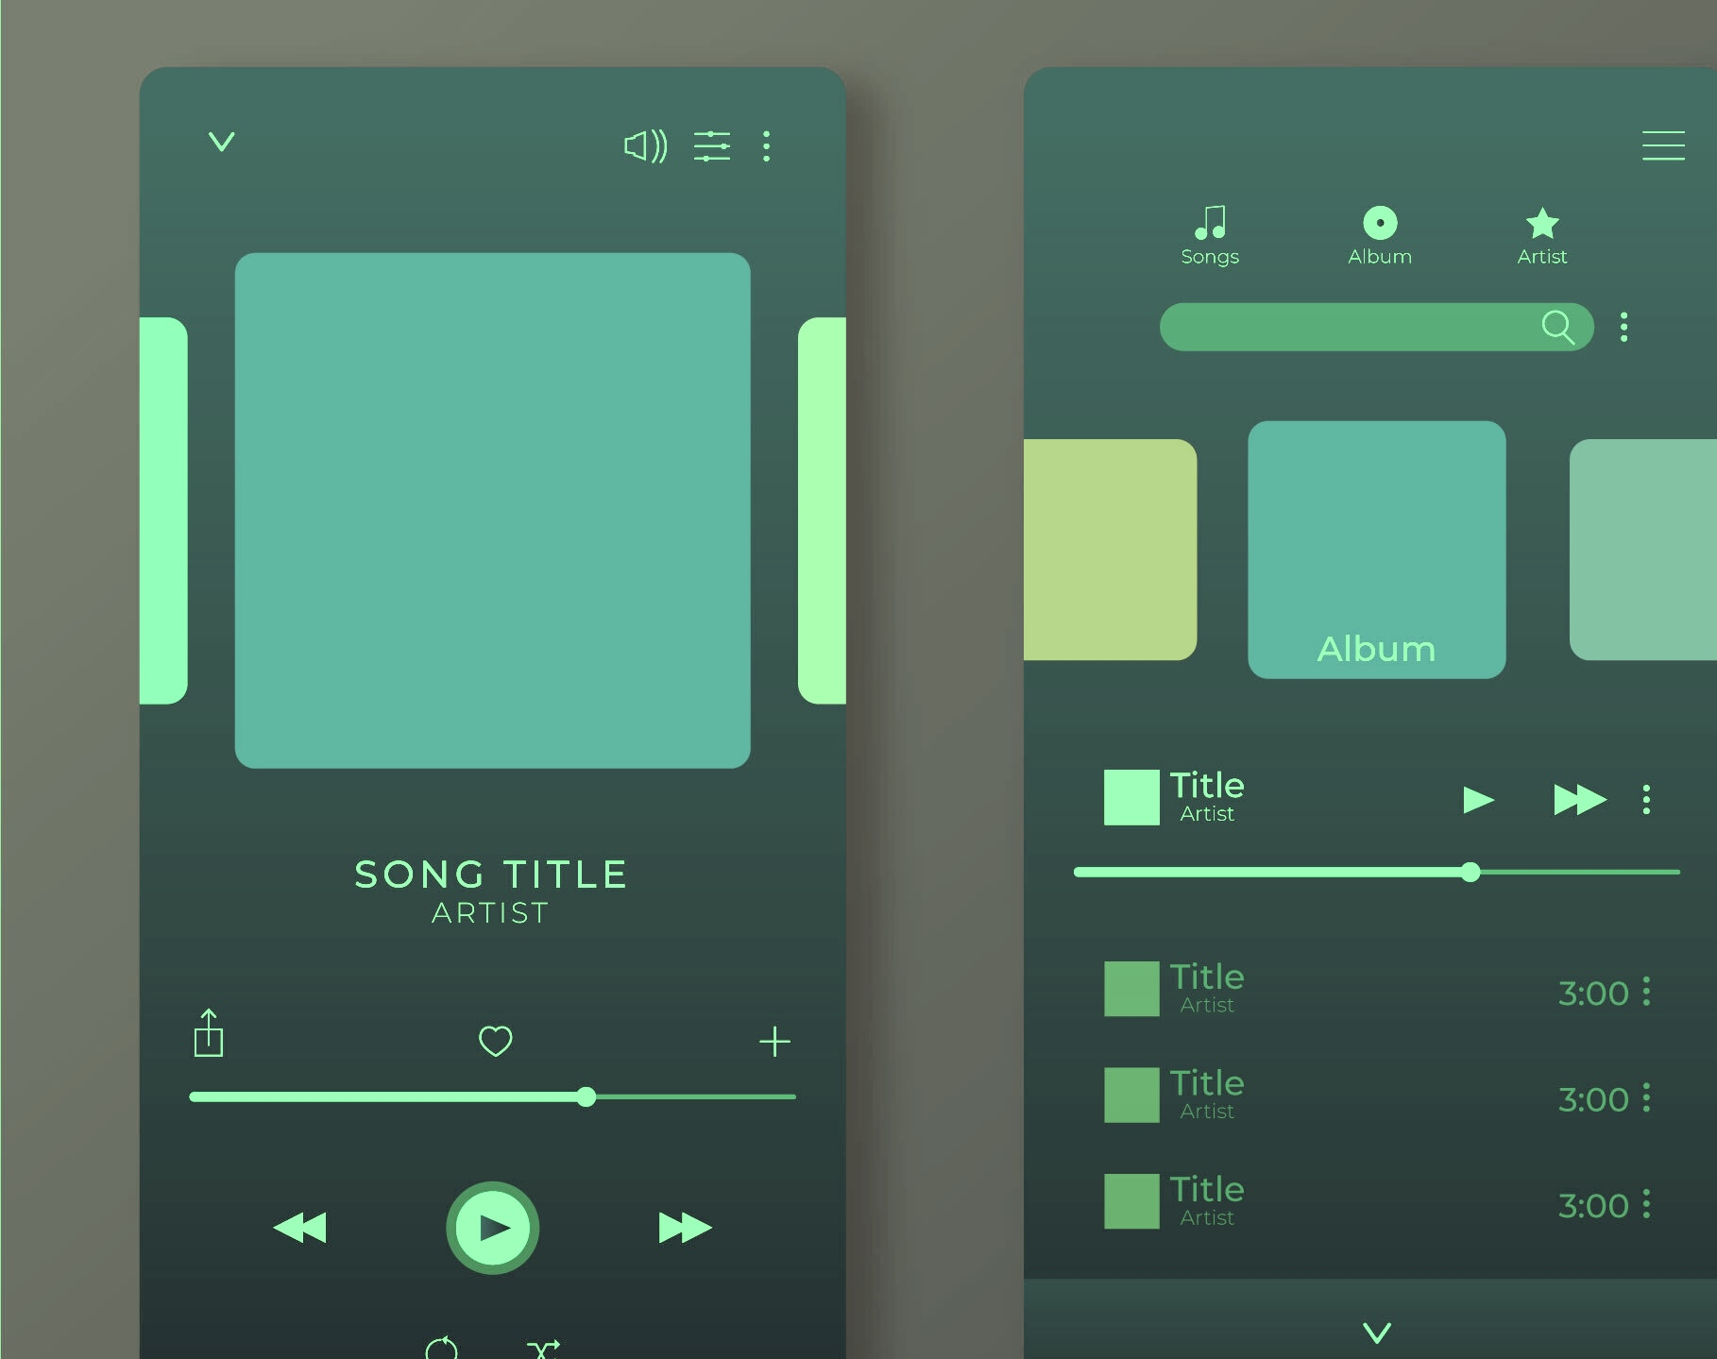
Song recommender demo
Muffeee
Have a coffee and listen to that music that resonates with people on a deeply emotional level

Slide 7
Thank you for your attention!

